Slide 1
Comprehensive Risk Assessment Framework for Dharavi
Serena Parve

Slide 2
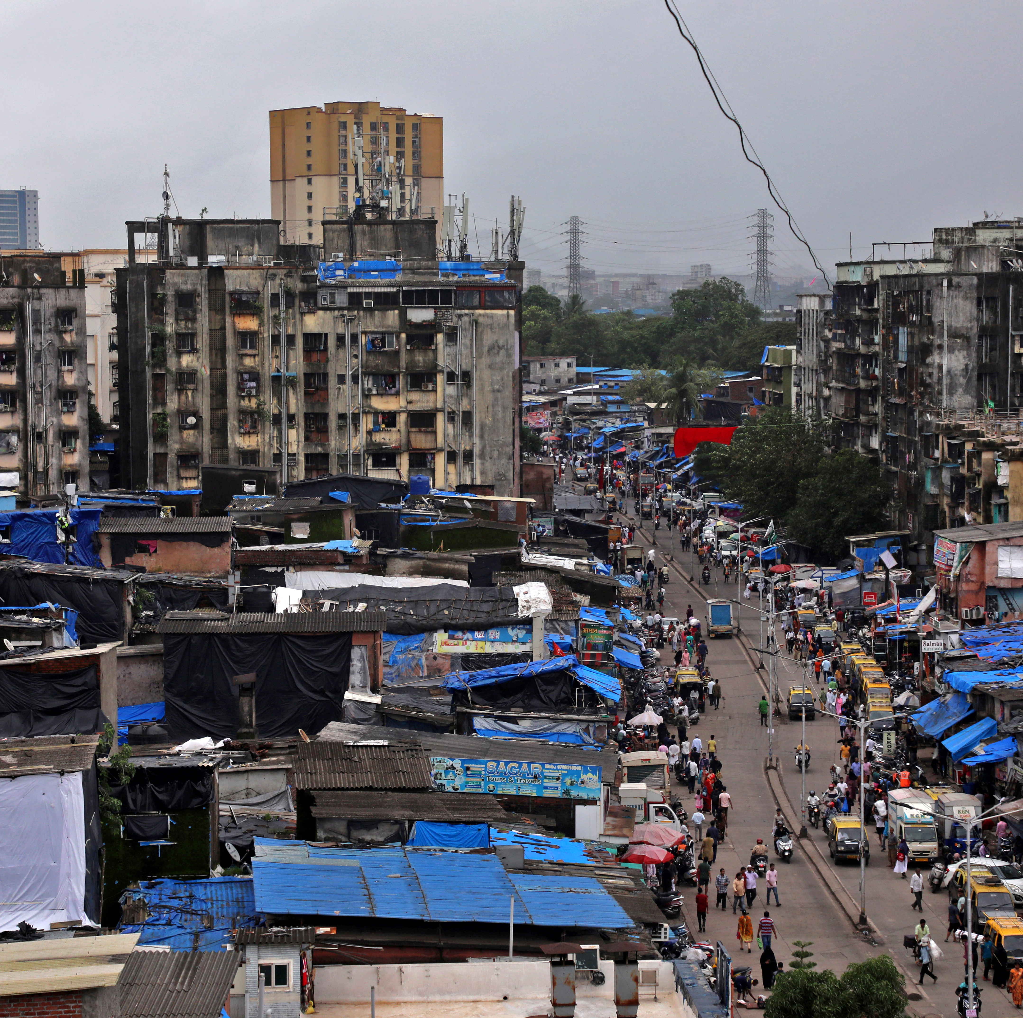
Context
Slum in Mumbai
591 Acres
700,000 – 100,000 Residents
Home to small scale industries
Extremely susceptible to risks
Disasters can be deadly
Notes:
Dharavi is a densely populated slum in Mumbai, India, with an estimated population of between 700,000 and 1 million people. It is one of the largest slums in Asia and is known for its hazardous living conditions and high levels of poverty.
But Dharavi is not only squalor. There are also important businesses there with leather, textiles, pottery, jewelry, and steel being the most important industries, along with a large recycling business.
Dharavi also has a booming tourism industry, made famous by the movie, a lot of tourists who visit pay to have a full blown guided visit of Dharavi
Dharavi is home to a variety of industries, including small-scale manufacturing, recycling, and waste disposal. These industries contribute to the local economy, but they also pose significant environmental and health risks. The air and water in Dharavi are heavily polluted, and the soil is contaminated with hazardous substances.
In addition to environmental risks, Dharavi is also vulnerable to natural disasters, such as floods, fires, and earthquakes. These disasters can cause widespread damage to property and infrastructure, and they can also lead to loss of life.

Slide 3
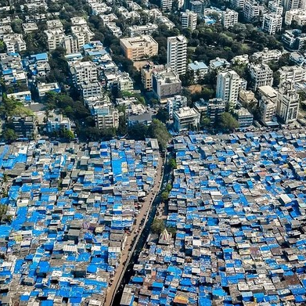
The Process
Define Scope
Identify Potential Risks
Analyze Risks
Rank Risks
Risk Management Strategies
Evaluate and Monitor
Implement

Slide 4
Define Scope
Identify Potential Risks
Analyze Risks
Rank Risks
Risk Management Strategies
Evaluate and Monitor
Implement

Slide 5
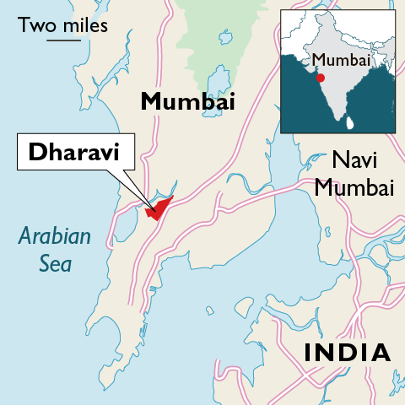
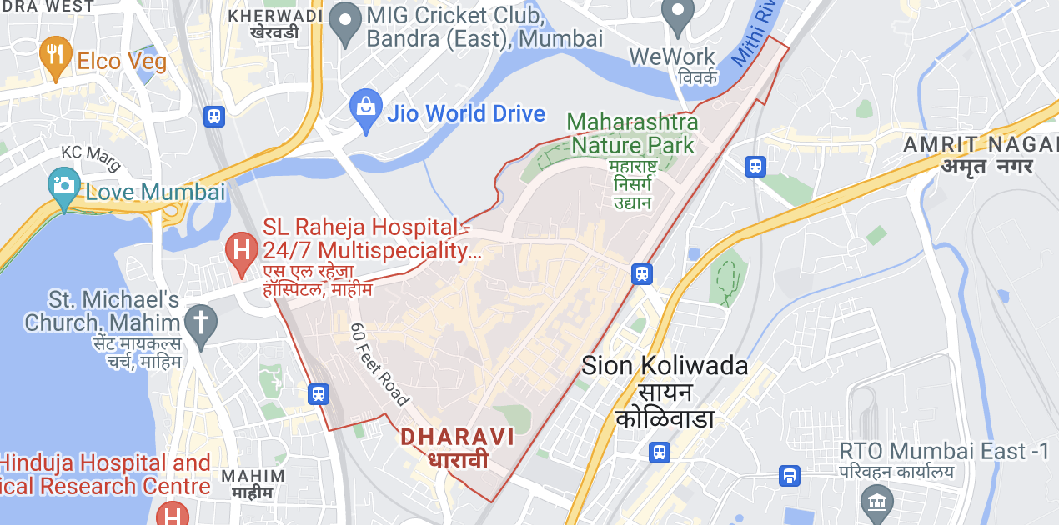
Scope

Slide 6
Scope
Kick Off Meeting
Divide Dharavi into sectors – Dharavi Constituency Assembly Workers
Pair up a Social Scientist and Community Outreach worker
Reach out to at least 5 varied households in each sector
Reach out to as many as possible non - households
Get the communities perspective on the risks they’ve faced
Report findings
Notes:
Kick off meeting – to explain the scope and early requirements to stakeholders – Dharavi Constituency assembly, and workers involved in the early stages.
What we’re doing is a form of participatory risj assessment. Although Dharavi is a high risk area, there haven’t been any extensive risk assessment done for it that considers all types of major risks
There are some historical records, some aggregate news and records of past risks and how they have affected the community.
What we really want to do is hear directly from the community about risks they’ve faced, how it affected them
To do this we will have to divide dharavi into sectors.
Next stage is actually doing the outreach.
This is where we plan to pair up ..
Ss – can understand the data t\hat is actually required and make sure that the outreach gathers the data. CO – good at talking to people.
30 sectors of about 20 acres each
2 teams Might take upto 1 week to cover 1 sector.
2 team can cover upto 12 sectors in 4 months – accounting for slack
So min is 10 -12 teams, but we’ll have 8 teams

Slide 7
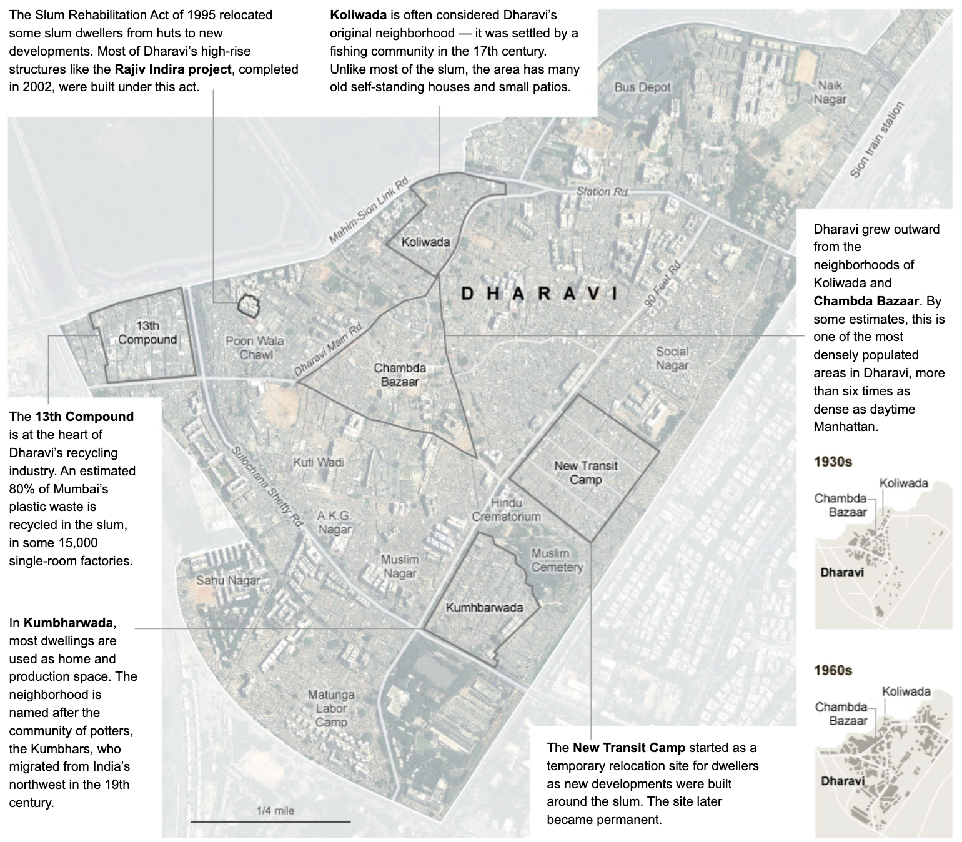
Notes:
Some of the neighborhoods form natural sectors, and we’ll form the other sectors using the help of Dharavi Constituency assembly

Slide 8
Scope
Households
What are some disasters that affected you?
How were people affected?
How did it affect your household?
How did this affect the resources around you?
How were your daily activities affected?
Non - Households
What are some disasters that affected the institution?
How were people affected?
How did it affect the property?
How did this affect the resources that the institution needs?
How were your daily operations affected?
Notes:
The basic goal of the outreach is to answer these 5 questions.
Asked to households and non – households, there’s just a slight difference between households and non – households.
And we’re going to see why we ask these exact questions in a bit
Finally we compile a report of all our findings

Slide 9
Identify Potential Risks
Natural Hazards | Other Hazards | Threats
Floods | Structural Failures | Terrorism
Cyclones | Industrial Accidents | Violence
Landslides | Electrical Hazards
Earthquakes | Plague
Heatwaves | Fires
Droughts | Chemical Spills
 | Explosions
Notes:
From the previous outreach and its report, from past historical data, and from scenario analysis we then identify potential risks.
Categorized by natural hazards, other hazards, and threats

Slide 10
Analyze Potential Risks
Look in the past
Historical Disasters
Understand Consequences – People, Property, Resources, Operations
Plan for the future
Expert Elicitation
Hypothesize Likelihood
Notes:
Analyzing the risk is divided into. 2 parts
We look at past historical disasters, and gather information from our initial findings, and understand the consequences on people, property…
Then we plan for the future, use the expert elicitation process to hypothesize likelihood

Slide 11
Historical Data and Scenario Analysis
Hazards / Impact | People | Property | Resources | Operations
Floods, Cyclones, Earthquakes, Landslides | Deaths, Injuries, Displacement | Buildings (Houses, Workplaces, Schools, Religious Places) Destroyed | Water Contamination, Goods Destroyed, Power Outages | Roads blocked, Industries Closed, Tourism paused, Schools / Clinics Closed
Heatwaves | Deaths, Illness | Minimal Damage | Water Scarcity | Outdoor Activities Disrupted, Healthcare operations strained
Violence | Deaths, Injuries, Displacement, Violence against minorities | Religious Places, Workplaces, Housing Damaged | Community Services Disrupted | Curfews Enforced, Disruption of Affected Workplaces, Religious places, Tourism Falls
Structural Failures | Deaths, Injuries, Displacement | Buildings Damaged, Collapsed | Goods destroyed | Strain in operations
Notes:
So, looking at historical data, data we got from our outreach and doing a scenario analysis, we can put together primary impacts of each kind of potential risk
For example, floods can cause deaths.

Slide 12
Historical Data and Scenario Analysis
Hazards / Impact | People | Property | Resources | Operations
Industrial Accidents | Deaths, Injuries, Illnesses | Factories Damaged | Air and Water Contamination | Affected Factories Strained, Tourism Strained
Electrical Hazards | Deaths, Injuries | Buildings, Houses Damaged | Power Outages | Affected Places Strained
Plague | Deaths, Illnesses | Minimal Damage | Shortages – Panic Buying | Healthcare Strained, Schools / Workplaces Closed, Tourism Falls
Fires | Deaths, Injuries, Displacement | Buildings, Houses Damaged | Goods Destroyed, Air Polluted | Affected Places Strained
Train Derailment | Deaths, Injuries | Buildings, Houses, Train Damaged | Goods Destroyed | Affected Places Strained

Slide 13
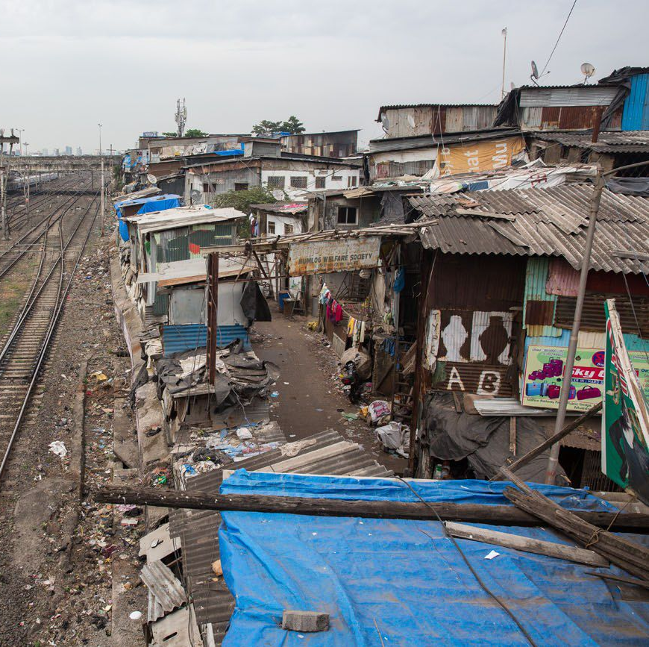
Expert Elicitation 1
Measuring Likelihood of risks
Substantive Experts – disaster experts, civil engineers, social experts
Gist of potential risks and consequence
Rank historical probability and future probability of risks
Anonymized revelation of answers
Repeat process
Normative experts put together likelihood of risks
Notes:
Then we will measure likeliohood of risks. We

Slide 14
Analyze Risks – Hypothesize Likelihood
Hazard / Threat | Historical | Probability | Likelihood
Floods | 4 | 4 | 8
Fires | 4 | 4 | 8
Violence | 3 | 3 | 6
Cyclones | 3 | 3 | 6
Structural Failures | 2 | 2 | 4
Drought | 3 | 2 | 5
Landslides | 2 | 2 | 4
Plagues | 2 | 1 | 3
Earthquakes | 1 | 1 | 2
Historical – Rating of historical occurrences of hazard
Probability – Rating of probability of hazard occurring in the future, without regarding history

Slide 15
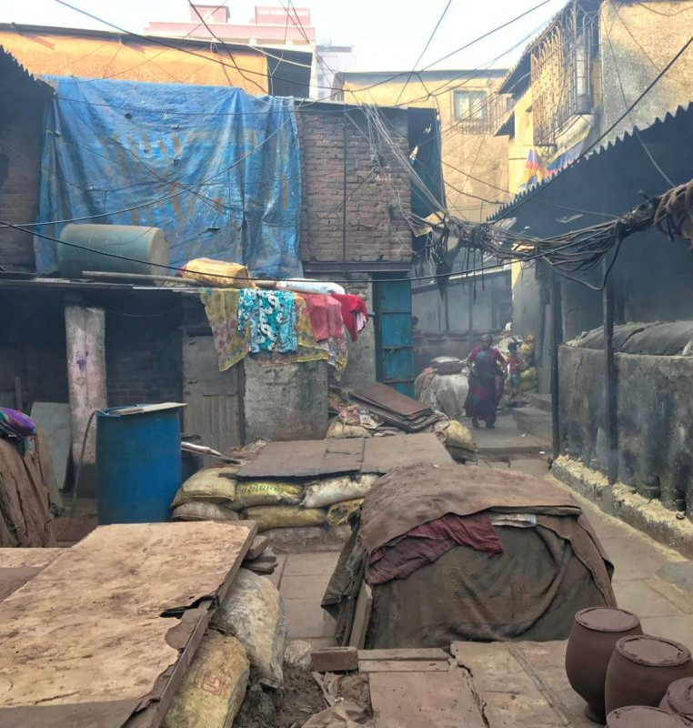
Rank Risks – Expert Elicitation 2
Measuring Impact of risks
2nd part of results of expert elicitation
Normative experts put together impact ranking
Risk = Likelihood x Impact
Put together ranking of risks

Slide 16
Rank Risks
Risk | Likelihood | Vulnerability | Spatial Extent | Magnitude | Impact | Risk Level | Rank
Floods | 8 | 5 | 4 | 5 | 14 | 112 | 1
Fires | 8 | 5 | 4 | 5 | 14 | 112 | 2
Violence | 6 | 5 | 4 | 5 | 14 | 84 | 3
Cyclones | 6 | 5 | 3 | 4 | 12 | 72 | 4
Structural Failures | 4 | 5 | 2 | 3 | 10 | 40 | 5
Drought | 5 | 4 | 3 | 4 | 11 | 55 | 6
Landslides | 4 | 3 | 2 | 3 | 8 | 32 | 7
Plagues | 3 | 3 | 2 | 3 | 8 | 24 | 8
Earthquakes | 2 | 3 | 2 | 3 | 8 | 16 | 9
Vulnerability – Rating of amount of people and property that would be affected Spatial Extent – Rating of geographical area that might be impacted Magnitude – Rating of severity of losses of people and property

Slide 17
Risk Management Strategies
Level |  | Risk | Strategy
Low Likelihood | Low Consequence | Low Risk | Accept
High Likelihood | High Consequence | High Risk | Avoid
All other combinations |  | Medium Risk | Transfer / Control
Snowstorm | Low Risk | Accept
Train Derailment | High Risk | Avoid - Construct sturdy wall between train lines and communities
Floods | Medium - High Risk | Control - Improve drainage, relocate low lying areas
Notes:
There have been 62 train derailments in Mumbai in the last 10 years or so,

Slide 18
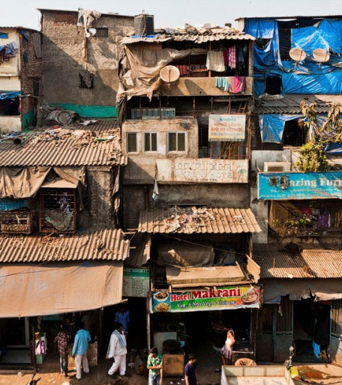
Risk Management Strategies
Evaluate each strategy based on:
Effectiveness on taking care of risk
Cost effectiveness
Adaptiveness
Community helpfulness and acceptance
Long term effectiveness
Notes:
Adaptiveness – the strategy has to be adaptive and flexible, it can’t be something that will control risk just once, or control risk minimally.
If you are aware of India’ current political climate, you would know that anytime elections come around – and even without elections these days – every other politician is spewing some kind of communal hate speeches.
Dharavi, being essentially a vote bank for politicians, is also a victim of this.
Imagine if the risk management strategy is putting in place a curfew during anticipated times of communal violence. It is a terrible way of controlling the risk because it doesn’t ensure that we’re reducing the possibility of risk, and not all communal violence is people getting on the streets and battling it out in groups. Infact its sinister, but there have been recent cases in India – in all kinds of societies, where people from a certain religious minority have been forced to move out from their homes because of polarization and hate speech. It’s not physical violence, but it is still communal violence, and a curfew doesn’t stop it at all.
Instead a good strategy here would be to actually enforce the laws we have against hate speeches, so that there is no motivation for communal violence at all.
We want the community to actually accept the strategies we’re proposing. Which again goes back to why we involved the community in the first place. Often times, however good an outsider’s intention, the steps we think we take to make things better for a community are actually not appreciated by them at all. For reasons that we may not understand as people who don’t actually have the lived experience. For example, I mentioned relocation for low lying areas as a strategy to mitigate floods, but people are often reluctant to relocate, because it disrupts their lives and it can have some financial implications for them.

Slide 19
Evaluate & Monitor
Risk Management Strategy
Implement
Evaluate
Report
Alter Strategy
Pilot Implementations
Communicate strategy to people
Implement preliminary strategies
Evaluate effectiveness
Identify disruption to communities
Identify possible failures of strategy
Feedback Loop
Final Report on Risks and Strategies
Large Scale Implementation

Slide 20
The Team
Dharavi Assembly Constituency Workers
Community Outreach Workers
Social Scientists
Experts – Disaster Experts, Social Experts, Chemical Experts, Civil Experts
Data Analysts
Risk Analysts
Notes:
Slum Rehabilitation Authority

Slide 21
Timeline
----- Define Scope -----
Kick Off Meetings | Jan 01 | Jan 03
Define Sectors | Jan 06 | Jan 08
Outreach Training | Jan 09 | Jan 20
Outreach and Data Collection | Jan 23 | May 26
Report and Initial Analysis | Jan 30 | Jun 09
----- Identify Potential Risks -----
Report Risks from Outreach | Jun 12 | Jun 16
Scenario Analysis | Jun 19 | Jun 23
Compile List of Risks | Jun 26 | Jun 30
-----Analyze Risks -----
Historical Data Collection and Analysis | Jul 03 | Jul 14
Expert Elicitation | Jul 17 | Jul 21
Rank Risks | Jul 24 | Jul 28
-----Risk Management Strategies -----
Accept, Avoid, Control Transfer | Jul 31 | Aug 11
Control, Transfer Strategies | Aug 14 | Sep 15
Evaluate Strategies | Aug 21 | Sep 22
-----Evaluate and Monitor -----
Pilot Implementation | Oct 02 | Nov 17
Evaluate Effectiveness | Oct 9 | Dec 15
Report Findings | Dec 18 | Dec 22
Alter Strategies | Jan 08 | Jan 26
Implement Strategies | Jan 29 | Feb 27
Final Report | Mar 4 | Apr 4
Notes:
Slum Rehabilitation Authority

Slide 22
References
Rao, BT; Thakur, JS. Vulnerability Assessment in Slums of Union Territory, Chandigarh. Indian Journal of Community Medicine 32(3):p 189-191, Jul–Sep 2007. | DOI: 10.4103/0970-0218.36824
Pal RK, Naik G, Rathore V, Sahu KK, Kumar R. Comparison between two different successful approaches to COVID-19 pandemic in India (Dharavi versus Kerala). J Family Med Prim Care. 2020 Dec 31;9(12):5827-5832. doi: 10.4103/jfmpc.jfmpc_1860_20. PMID: 33681002; PMCID: PMC7928144.
Tyagi, P. (2020). FLOOD RISK, COASTAL MEGACITIES, AND URBAN POOR: ASSESSING THE FUTURE URBAN FLOOD RISK IN THE H/E WARD OF MUMBAI. Journal of Urban and Environmental Engineering, 14(2), 191-203. doi:https://doi.org/10.4090/juee.2020.v14n2.192203
Samaddar, S., Choi, J., Misra, B.A. et al. Insights on social learning and collaborative action plan development for disaster risk reduction: practicing Yonmenkaigi System Method (YSM) in flood-prone Mumbai. Nat Hazards 75, 1531–1554 (2015). https://doi.org/10.1007/s11069-014-1380-4
Samaddar, S., Si, H., Jiang, X. et al. How Participatory is Participatory Flood Risk Mapping? Voices from the Flood Prone Dharavi Slum in Mumbai. Int J Disaster Risk Sci 13, 230–248 (2022). https://doi.org/10.1007/s13753-022-00406-5
Rodanthi T. (1989), “Beyond the stereotype of slums; how poor people find accommodation in Third World cities”, Environment and Urbanization, Vol. 1, No 2, available at http://eau.sagepub.com/content/1/2.toc. Routledge, Abingdon and New York
Samaddar, S., Tatano, H., Pasupuleti, R.S. (2021). Evaluating the Success of Participatory Flood Risk Mapping—A Case Study from Dharavi, Mumbai. In: Tatano, H., Collins, A. (eds) Proceedings of the 3rd Global Summit of Research Institutes for Disaster Risk Reduction. GSRIDRR 2017. Disaster and Risk Research: GADRI Book Series. Springer, Singapore. https://doi.org/10.1007/978-981-15-8662-0_10
Kaushal J, Mahajan P. Asia's largest urban slum-Dharavi: A global model for management of COVID-19. Cities. 2021 Apr;111:103097. doi: 10.1016/j.cities.2020.103097. Epub 2021 Jan 12. PMID: 33519012; PMCID: PMC7832248.
Hu J, Xie X, Shu X, Shen S, Ni X, Zhang L. Fire Risk Assessments of Informal Settlements Based on Fire Risk Index and Bayesian Network. Int J Environ Res Public Health. 2022 Nov 25;19(23):15689. doi: 10.3390/ijerph192315689. PMID: 36497763; PMCID: PMC9735542.

